Slide 1
Developer Training
Translation Management Framework (TMF)

Slide 2
Introduction

Slide 3
Objectives
Provide an overview of the Translation Model Framework and why it’s needed.
Introduce the capabilities and features of the TMF.
Illustrate various configuration options.

Slide 4
Global Markets
汉语 $1.1 Trillion GDP 276m online users | Deutsch $2.8 Trillion GBP 61m online users | 日本語 $4.3 Trillion GDP 94m online users
العربية $1 Trillion GDP 59m online users | English $14 Trillion GDP 464m online users | Español $3.1 Trillion GDP 124m online users
Français $2.2 Trillion GDP 68m online users | Italiano $1.4 Trillion GDP 34m online users | 한국어 $1.6 Trillion GDP 34m online users

Slide 5
Common Globalization Models
Internal
External
Decentralized
Centralized team at HQ
In-house translation
Parallel, pre-configured workflows
⚠️ System Compatible To Double Byte
Centralized team at HQ
Outsourced translation
Workflow with external translation agency via API
⚠️ System Compatibility
Decentralized team
Automatic workflow notifications
Independent publishing, autonomous sites
⚠️ Standardized template to protect branding

Slide 6

Common Globalization Models
Internal
External
Decentralized
Content
Editing
L10N
Content
Editing
L10N
Content
Editing
Content
Editing
Content
Editing
EN
DE
ES
API
DXM
DXM
DXM
Content Delivery
Content Delivery
Content Delivery
Content Delivery
Content Delivery
Content Delivery

Slide 7
TMF

Slide 8
TMF is
Template-based DXM extension
Enables management of multi-lingual content
Manages Primary / Follower content relationships
Can designate content owners by language, country and locale
Can notify content owners when primary / follower content is modified

Slide 9
TMF is not
A translation services toolkit
Provided with any translation service integrations built in.

Slide 10
LEAD/FOLLOWER CONCEPT
en-US/
en-GB/
es-MX/
Primary content (lead asset) is created.
Content asset
Content editor chooses to distribute content to other locales configured through TMF. This creates clones of the lead content – follower assets .
Content asset
Content asset
Regional editor(s) edits the follower assets to perform translation, localization etc.
Content asset
Content asset
Content editor creates a branch of the lead content and makes some changes. They have the option to re-distribute to one or more followers (over writing the follower content), or just let the regional editor be notified of changes.
Content asset
Content asset
Regional editor(s) edits the follower assets to perform translation, localization etc.
Content asset
Content asset

Slide 11
TMF Configuration

Slide 12
Configuration
All configuration files should be in a «_TMF» folder under the site root
/_TMF |  | Top-level configuration folder
/Country Sites Config |  | Configuration of each country
Great Britain Mexico United States |  | Individual country & owner(s) configurations
/Languages Config |  | Languages
English Spanish |  | Individual language & owner(s) configurations
/Locales Config |  | Configuration of locales: a combination of country, language and a root folder
en-gb en-us es-us es-mx |  | Individual language & owner(s) configurations

Slide 13
Country & Language Configs
Configuration of the available countries and languages
Each allows one or more users to be specified to receive notifications

Slide 14
Locale Config
Combines country, language and root folder details
Each allows one or more users to be specified to receive notifications
Optional Translation Rules config
  Overrides site configuration?

Slide 15
TMF User Interface

Slide 16
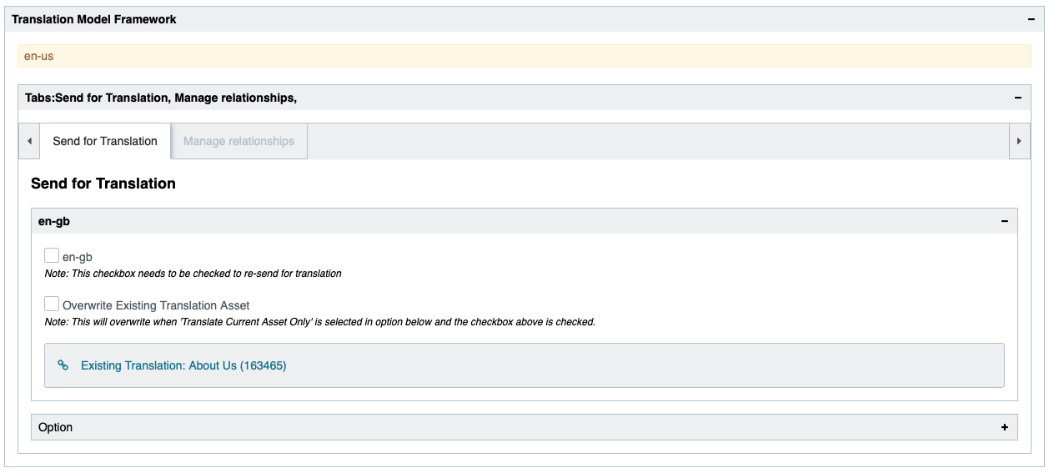
TMF UI: Distribute

Slide 17
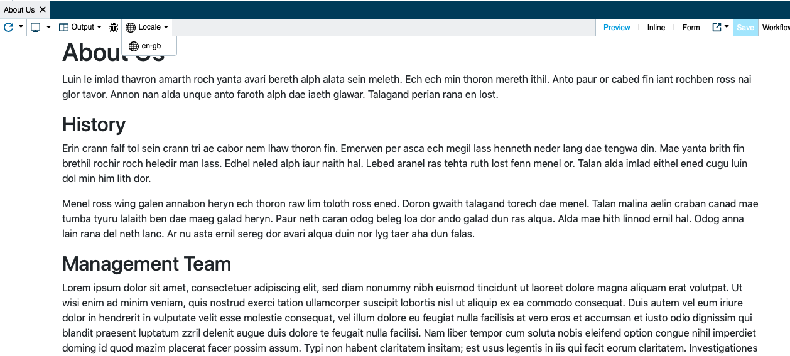
TMF UI: Locale Link on Preview

Slide 18
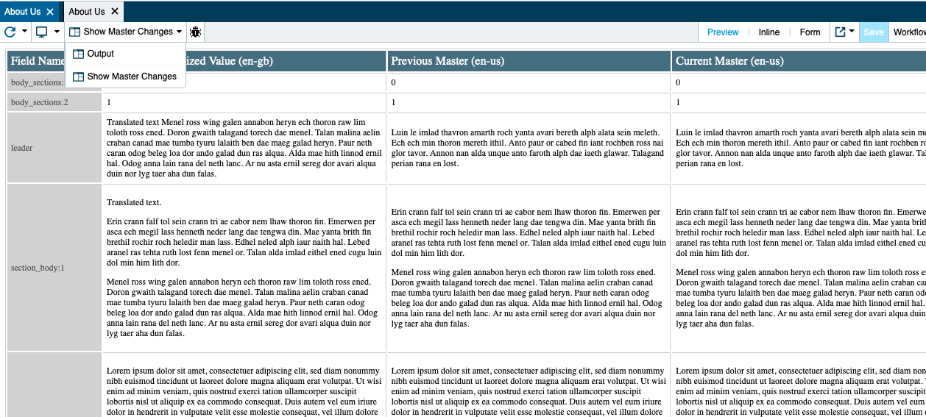
TMF UI: Review changes

Slide 19
External Translation

Slide 20
External Translation
Translation itself is independent of TMF
Most implementations take a workflow-based approach as this allows code (event handlers) to be invoked at relevant points in the asset lifecycle.
Draft
Deploy to stage
Stage
Deploy to live
Basic Workflow
Live
Send for translation
Translation Workflow
In Translation
In Review
Approve translation
Translation ready
Webhook Listener

Slide 21
Thank You!

